Slide 1
Installation Guide
(SCM – Tortoise SVN 1.6.3)
2009. 07. 21
CODELABOR
Shin Sang Jae (codelabor@gmail.com)

Slide 2
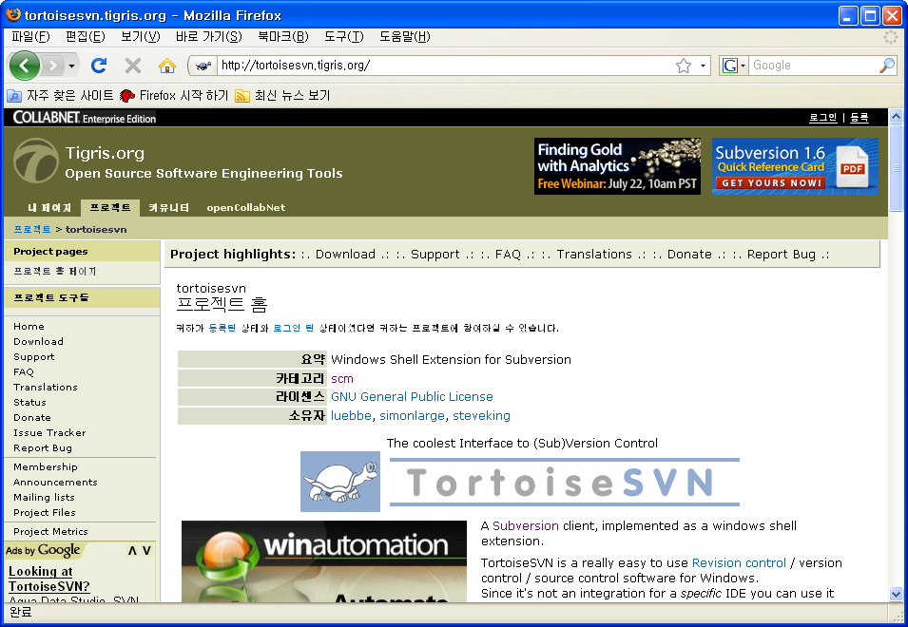
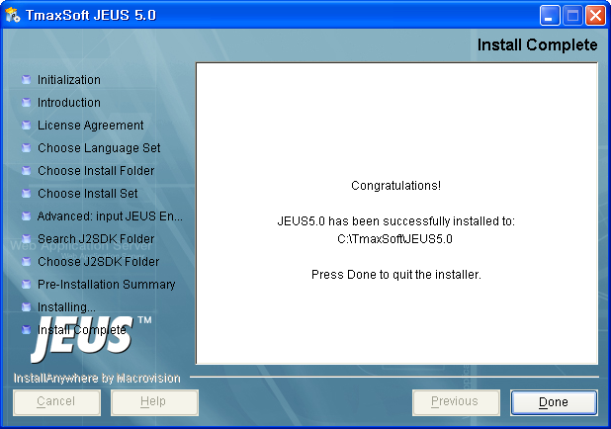
Tortoise SVN
Site
Official Site: http://tortoisesvn.tigris.org/

Slide 3
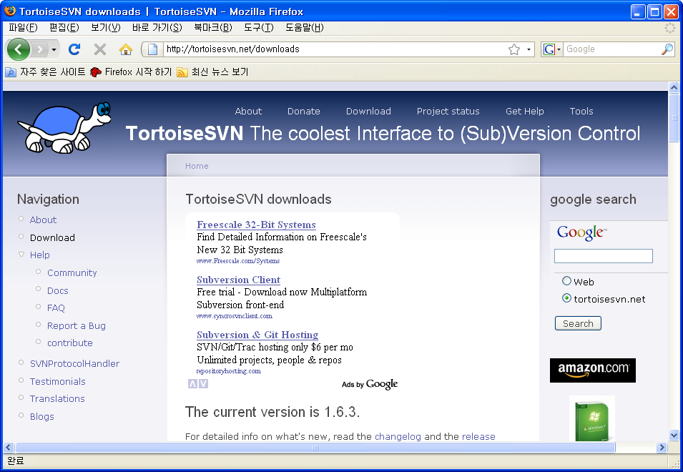
Tortoise SVN
Download
Download Site URL: http://tortoisesvn.net/downloads

Slide 4

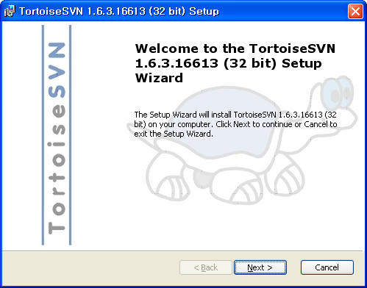
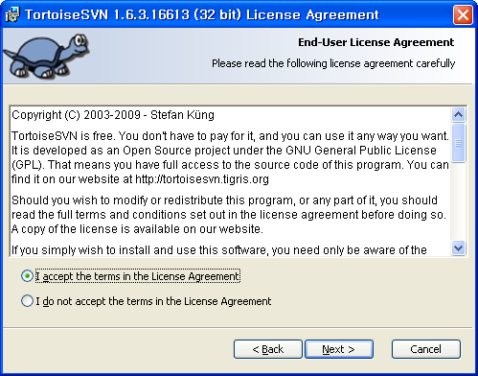
Tortoise SVN
Install
File: TortoiseSVN-1.6.3.16613-win32-svn-1.6.3.msi

Slide 5
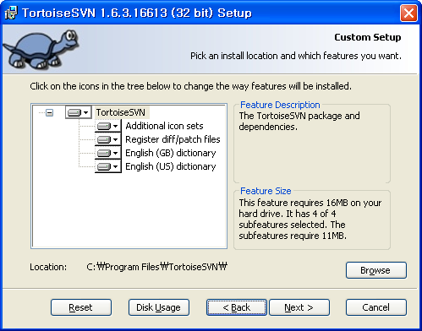
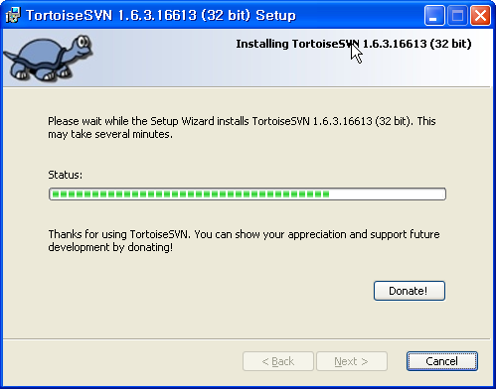
Tortoise SVN
Install
Location: C:\Program Files\TortoiseSVN

Slide 6
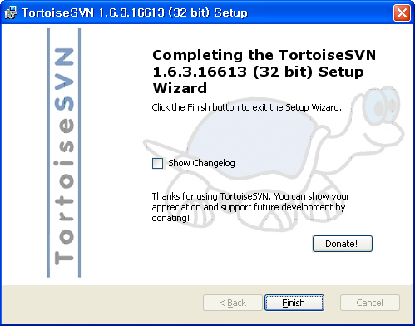
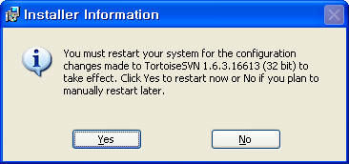
Tortoise SVN
Install
Restart

